Slide 1
Power BI Quick Start Kit

Slide 2
Microsoft Resources
Powerbi.com
Power BI Guided Learning
Power BI Team Blog
Power BI Feedback
Power BI Edx Course
Guy in a Cube (Youtube channel)
Microsoft Custom Visuals Gallery

Slide 3
Community Resources
Pluralsight Power BI course
SQLBI.com
Daxpatterns.com
PowerPivotPro.com
Chris Webb’s blog
Dustin Ryan’s blog
Kasper De Jong’s blog
SQLPASS.org
SQLSaturday.com
Power BI User Groups
SQLChicken Github repo (data samples)

Slide 4
Community Tips/Tricks
R Maps in Microsoft Power BI: Small Multiples
Dynamic Chart Titles
Power BI Custom Visuals series (Devin Knight)
Improve Performance with DirectQuery by using Inner Joins
Use SVG Images in Power BI: Part 1 (of 3)

Slide 5
Community Tips/Tricks
Preparing for Power BI Certification Exam
Power BI Sample Reports
Data Quality using PBI/Flow/PowerApps
Create App-like Experience with Bookmarks
Business Applications Summit (all sessions on-demand)

Slide 6
Tools
Power BI Desktop
Power BI Publisher for Excel (Excel 2007+)
Data Gateways

Slide 7
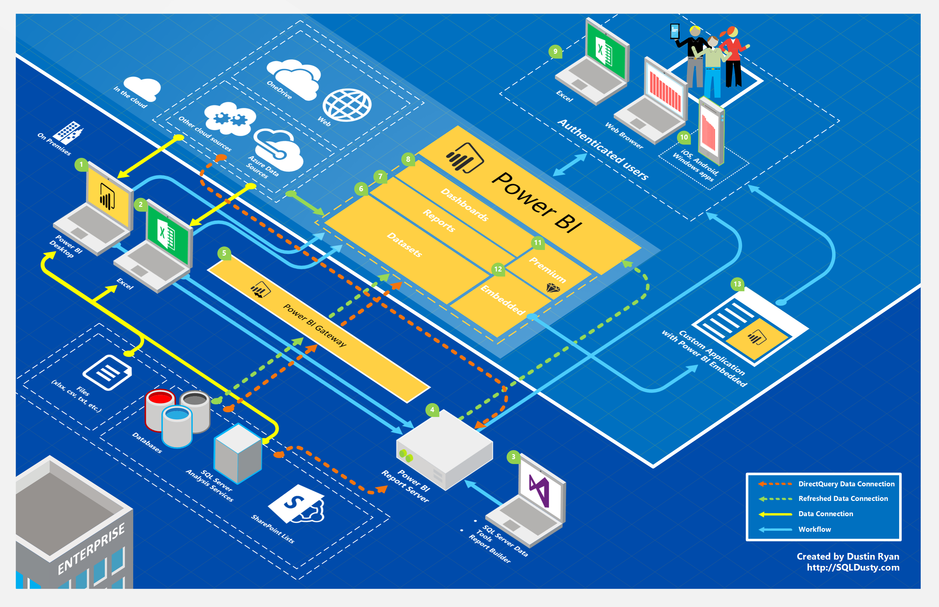

Slide 8
